Slide 1
Counting process

Slide 2
Contents of the Presentation
Session No. | Name of the Topic | Total no. of Slides
I
 | 1.1 Major legal provisions related to counting 1.2 Infrastructure and security arrangements at counting centre 1.3. Appointment of counting staffs and counting agents | 58
II | Counting of votes received through postal ballot / ETPBS
III | Counting of votes recorded in EVM-VVPATs
IV | 4.1 Declaration of results
 | 4.2 Sealing of EVM-VVPATs and other papers
 | 4.3 Miscellaneous issues

Slide 3
1.1
Major Legal Provisions related to Counting

Slide 4
Major legal provisions related to counting and election return
R.P. ACT 1951
Sec 64: Counting of Votes
Sec 64A: Destruction, loss etc. of ballot papers at the time of counting
Counting under supervision and direction of the Returning Officer
RO shall immediately report the matter to ECI who may direct the counting to be stopped.
Contesting candidate /election agent/ /counting agents have a right to be present.
Or if satisfied the result of election will not get materially affected, may allow counting to be completed.
ECI may further declare poll to be void, order re-poll for that polling station.

Slide 5
Major legal provisions related to counting and election return
RP ACT 1951 ( Contd)
Sec 65: Equality of Votes
Result to be decided by draw of lot by RO.
Sec 66: Declaration of Results
In the absence of any direction to the contrary from ECI, RO to declare the result on completion of counting.
Sec 67: Report of the Result
RO to report result to ECI & to Appropriate Authority (i.e. Secretary State Legislature/ Parliament, who shall get it published in official Gazette immediately.

Slide 6
Major legal provisions related to counting and election return
Sec 128: Maintenance of secrecy of voting
Applicable to officer/clerk/agent/person performing duty in connection to Election ( during poll or counting).
RO/ARO should take an oath to maintain secrecy of voting & read it out aloud before the commencement of counting of votes.
Sec 129: Officers, etc. at elections not to act for candidates or to influence voting
Applicable to DEO/RO/AROs/Polling staff.
Imprisonment up to 6 months /fine/both .
Sec 136: Other offences and penalties thereof [Sub sections to (1)-(4)]
Guilty of electoral offence: tampering with EVM/ballot box or ballot paper /nomination paper etc fraudulently
Imprisonment up to 6 months or 2 years /fine /both
Violation punishable with 3 months imprisonment or fine or with both.

Slide 7
Major legal provisions related to counting and election return
CONDUCT OF ELECTIONS RULES, 1961
Rule 66A: In relation to counting of votes where EVMs are used, the provisions of Rules 50-54 have been made applicable. And in lieu of Rule 55, 56 and 57, Rules 55C, 56C and 57C have been made applicable.

Slide 8
Major legal provisions related to counting and election return
Conduct of Elections Rules, 1961
Rule 51: Time and place for counting
To be fixed by RO at least one week before date of poll
Rule 52 : Appointment of Counting Agents
Subject to ECI directions, a candidate may appoint counting agents which shall not exceed 16 for each place of counting
Notice to be given in writing to each candidate/his election agent
Appointment to be made in FORM 18, in duplicate. One copy for RO for record and other copy to agent for production before RO, not later than one hour before the time fixed for counting
Revocation in FORM 19
No entry in counting hall unless second copy of FORM 18 is given to RO after signing the declaration

Slide 9
Major legal provisions related to counting and election return
Rule 53: Admission to the place of counting
No body else except RO/ARO, counting staff, candidates, their election agents and counting agents public servants on duty, persons authorized by ECI
Rule 54: Secrecy of voting
RO to read out provision of section-128 aloud before commencement of counting.
Whosoever misconducts himself or fails to obey lawful direction of RO shall be removed from the counting hall.

Slide 10
Major legal provisions related to counting and election return
Rule 55C: Scrutiny and inspection of EVMs before counting. Counting staff and counting agents to inspect and ensure that the CU is not tampered and all seals are intact. In case not, report matter to ECI
Rule 56C: Actual counting
1. Press the result button and see the display of votes count.
2. Note down the same in part-II of form 17C. Counting supervisor to sign on it along with candidates or their election agents or counting agents
3. Corresponding entries to be made in form-20

Slide 11
Major legal provisions related to counting and election return
Rule 56D Scrutiny of paper trail –
(1) Where printer for paper trail is used, after the entries made in the result sheet are announced, any candidate, or in his absence, his election agent or any of his counting agents may apply in writing to the returning officer to count the printed paper slips in the drop box of the printer in respected of any polling station or polling stations.
(2) On such application being made, the returning officer shall, subject to such general or special guidelines, as may be issued by the Election Commission decide the matter and may allow the application in whole or in part or may reject in whole, if it appears to him to be frivolous or unreasonable.
(3) Every decision of the returning officer under sub-rule(2) shall be in writing and shall contain the reasons therefor.

Slide 12
Major legal provisions related to counting and election return
Rule 57C: Sealing of voting machines.-
After result of voting recorded in a CU has been entered in Part-II of Form 17C, the CU is to be resealed with the seals of the RO and candidates/ election agents present.

Slide 13
Major legal provisions related to counting and election return
Rules 60 provides for continuous counting
Rule 61 provides for re-commencement of counting after fresh poll
Rule 63 provides for recount of votes
Rule 64 provides for declaration of result of election
Rule 66 provides for grant of certificate of election to returned candidate
Rule 65 provides for counting at 2 or more places for one constituency

Slide 14
1.2 Infrastructure and security arrangements at counting centres

Slide 15
Infrastructure and security arrangements at counting centres
Counting place should be decided in consultation with police authorities at least one week before the date of poll. (If poll being taken in phases then the first date)
ECI fixes a common date and time of counting which shall have to be intimated to contesting candidates well in advance (As per Annexure 43-A or 43-B)
Preferably place of counting of a constituency should be in district HQ. No objection if it is outside the area for cogent reasons.

Slide 16
Infrastructure and security arrangements at counting centres
Each constituency should be counted in a separate hall. Under no circumstances more than one AC segment will be taken up for counting simultaneously in the same hall. (No exception. In case adequate halls are not available, then counting to be done in sequence i.e. first, one AC counting will be completed and thereafter the next one).
In simultaneous poll to Lok Sabha and Legislative Assembly, both to be counted in the same hall. Half of the tables for LS and other half for LA i.e. one side for Lok Sabha and the other side for LA.

Slide 17
Infrastructure and security arrangements at counting centres
RO needs to forward the proposal of counting centres in consultation with the observer in Annexure 42-C of HB of RO to ECI through CEO for approval at the earliest after last date for withdrawal of candidature.
After ECI has approved the same a mandatory notice to candidates has to be given in Annexure 43-A or 43-B of Hand Book of RO.
If, for any unavoidable reasons, the RO is unable to conduct counting on notified date /time, he should postpone counting to another date and time after obtaining approval of ECI.
The counting should not be done in a temporary structure.

Slide 18
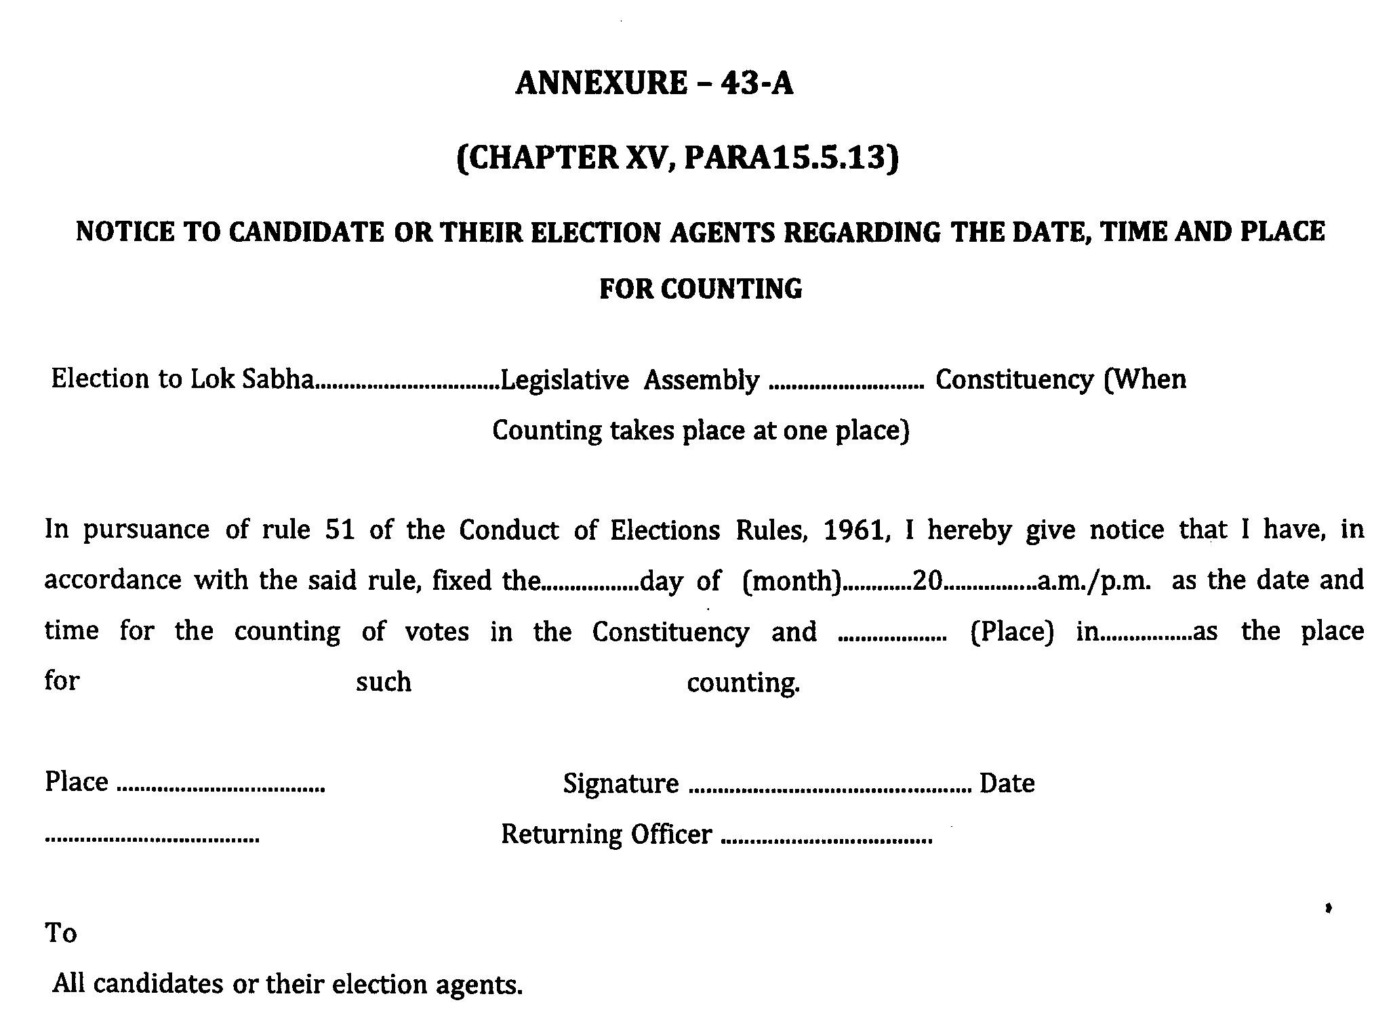

Slide 19
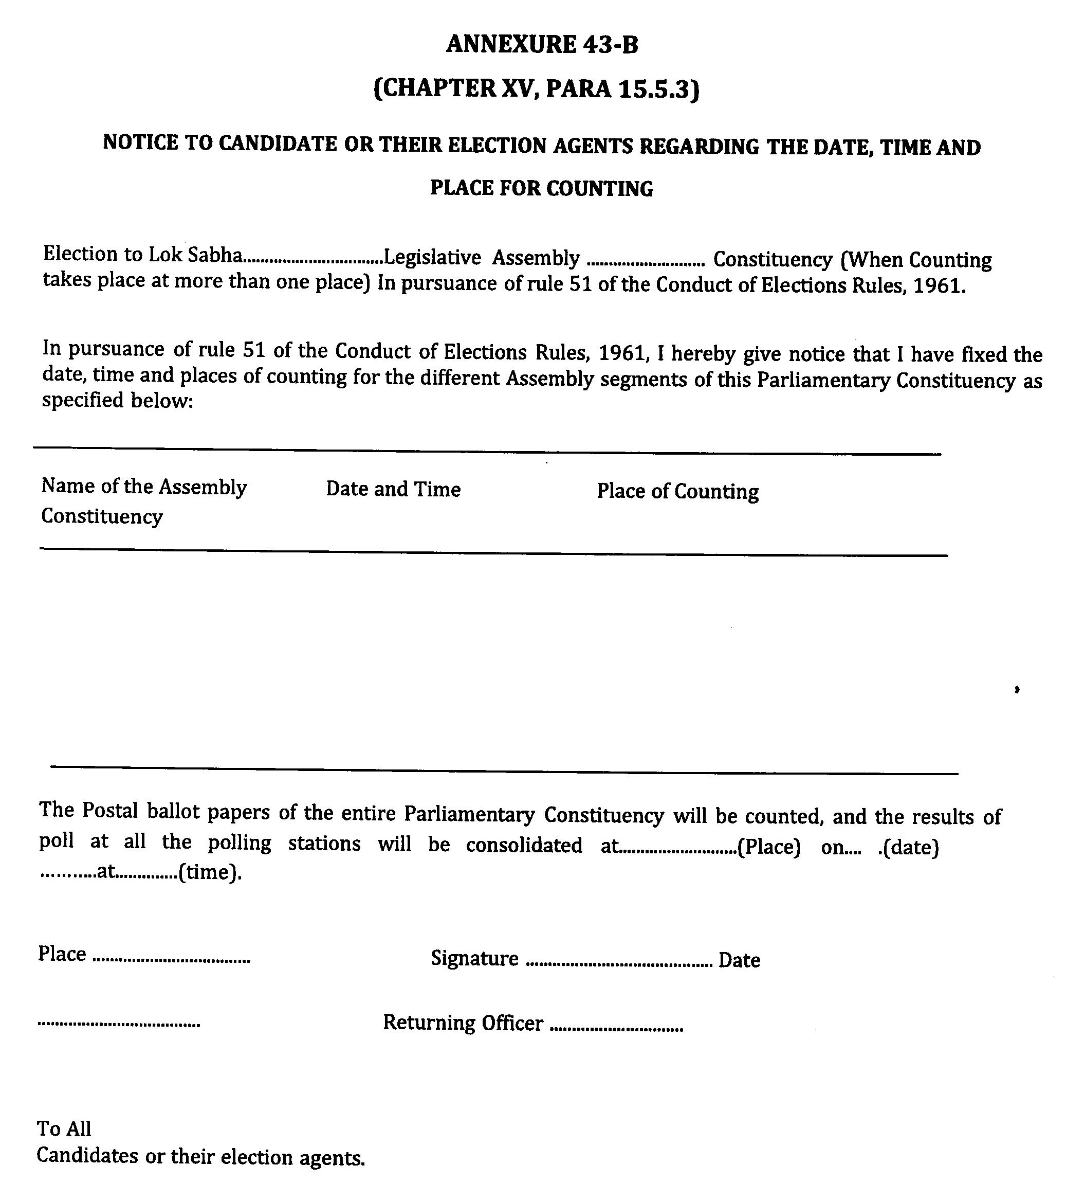

Slide 20
Infrastructural and security arrangements at counting centers
Counting of votes for entire Assembly segment to be preferably done at one hall/ place
If more than two halls or places are required, ECI’s written prior approval is required
In case 2 halls are approved, allot in advance the PS to be counted in each hall. Intimate candidates accordingly
For Each AC or assembly segment there should be a strong room and a spacious counting hall with separate entry and exit.
Each counting centre to have distinct number and each hall to be distinctly numbered

Slide 21
Infrastructural and security arrangements at counting centres
Should be spacious enough to accommodate infrastructure and officials and agents
Should have adequate lighting with proper standby arrangements (generator, etc.)
Adequate fire extinguishing equipment
Should be a permanent structure.
If unavoidably temporary, take ECI approval
Infrastructure at Counting Centre

Slide 22
Infrastructural and security arrangements at counting centres
No. of tables in counting hall depends upon
  No. of polling stations to be counted.
  Space available
  No. of counting agents
  No. of counting staff including micro-observers
  Security concerns
In one hall, counting tables should not exceed 14 (during last Lok Sabha elections 2014, even 25 tables were allowed, with ECI’s prior approval, provided hall was big enough). In addition to this one table each for RO and observer.

Slide 23
Infrastructural and security arrangements at counting centres
The candidates or their agents will be allowed to sit on ROs Table to watch the counting process.
A table with computer on which computation and compilation of data from each table after each round shall be done, should be alongside of ROs table.
If the tabulation is done at the table other than ROs table then one additional counting agent besides micro observer will be allowed to sit in on the tabulation table.
Adequate barricades using woodblock and wire-mesh for each counting table to prevent agents/candidates/representatives from handling polled EVMs, but agents should be able to view entire process

Slide 24
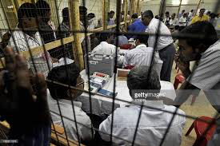


Counting Hall Arrangements
Barricade of woodblock and wire-mesh
PB counting preferably in same hall.
Tables- RO, Observer, PB/ETPBS, EVM Counting Tables, One counting table as VCB (VVPAT Counting Booth), Compilation
Blackboard/ Whiteboard

Slide 25

Counting Hall Arrangements
Emergency light/ Generator
Fire fighting equiments
Public Address System
Photocopier Machine
Videography
Drinking Water
Provide at every counting table, a blue ballpoint pen, paper knife for breaking open seals, two sheets of paper and Carbon Paper, Part II of Form 17-C, Round wise movement sheet of EVMs
Proforma for recording of votes secured by each candidate and NOTA by additional counting staff/ Micro observer
Sealed power packs of EVMs to be used in case of battery failures.

Slide 26
Infrastructure and security arrangements at counting centres

Slide 27
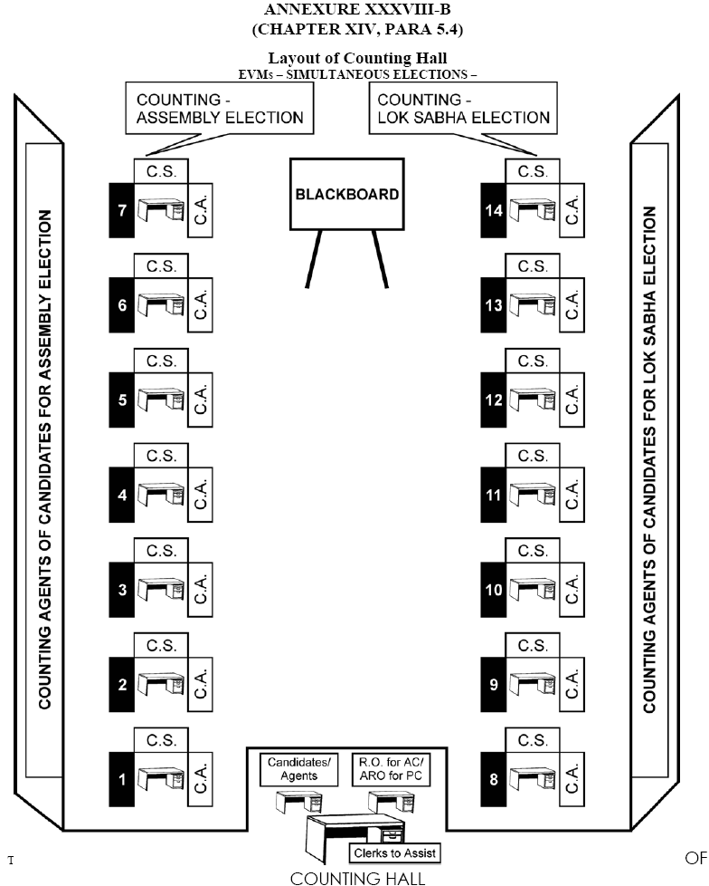
Infrastructure and security arrangements at counting centres

Slide 28
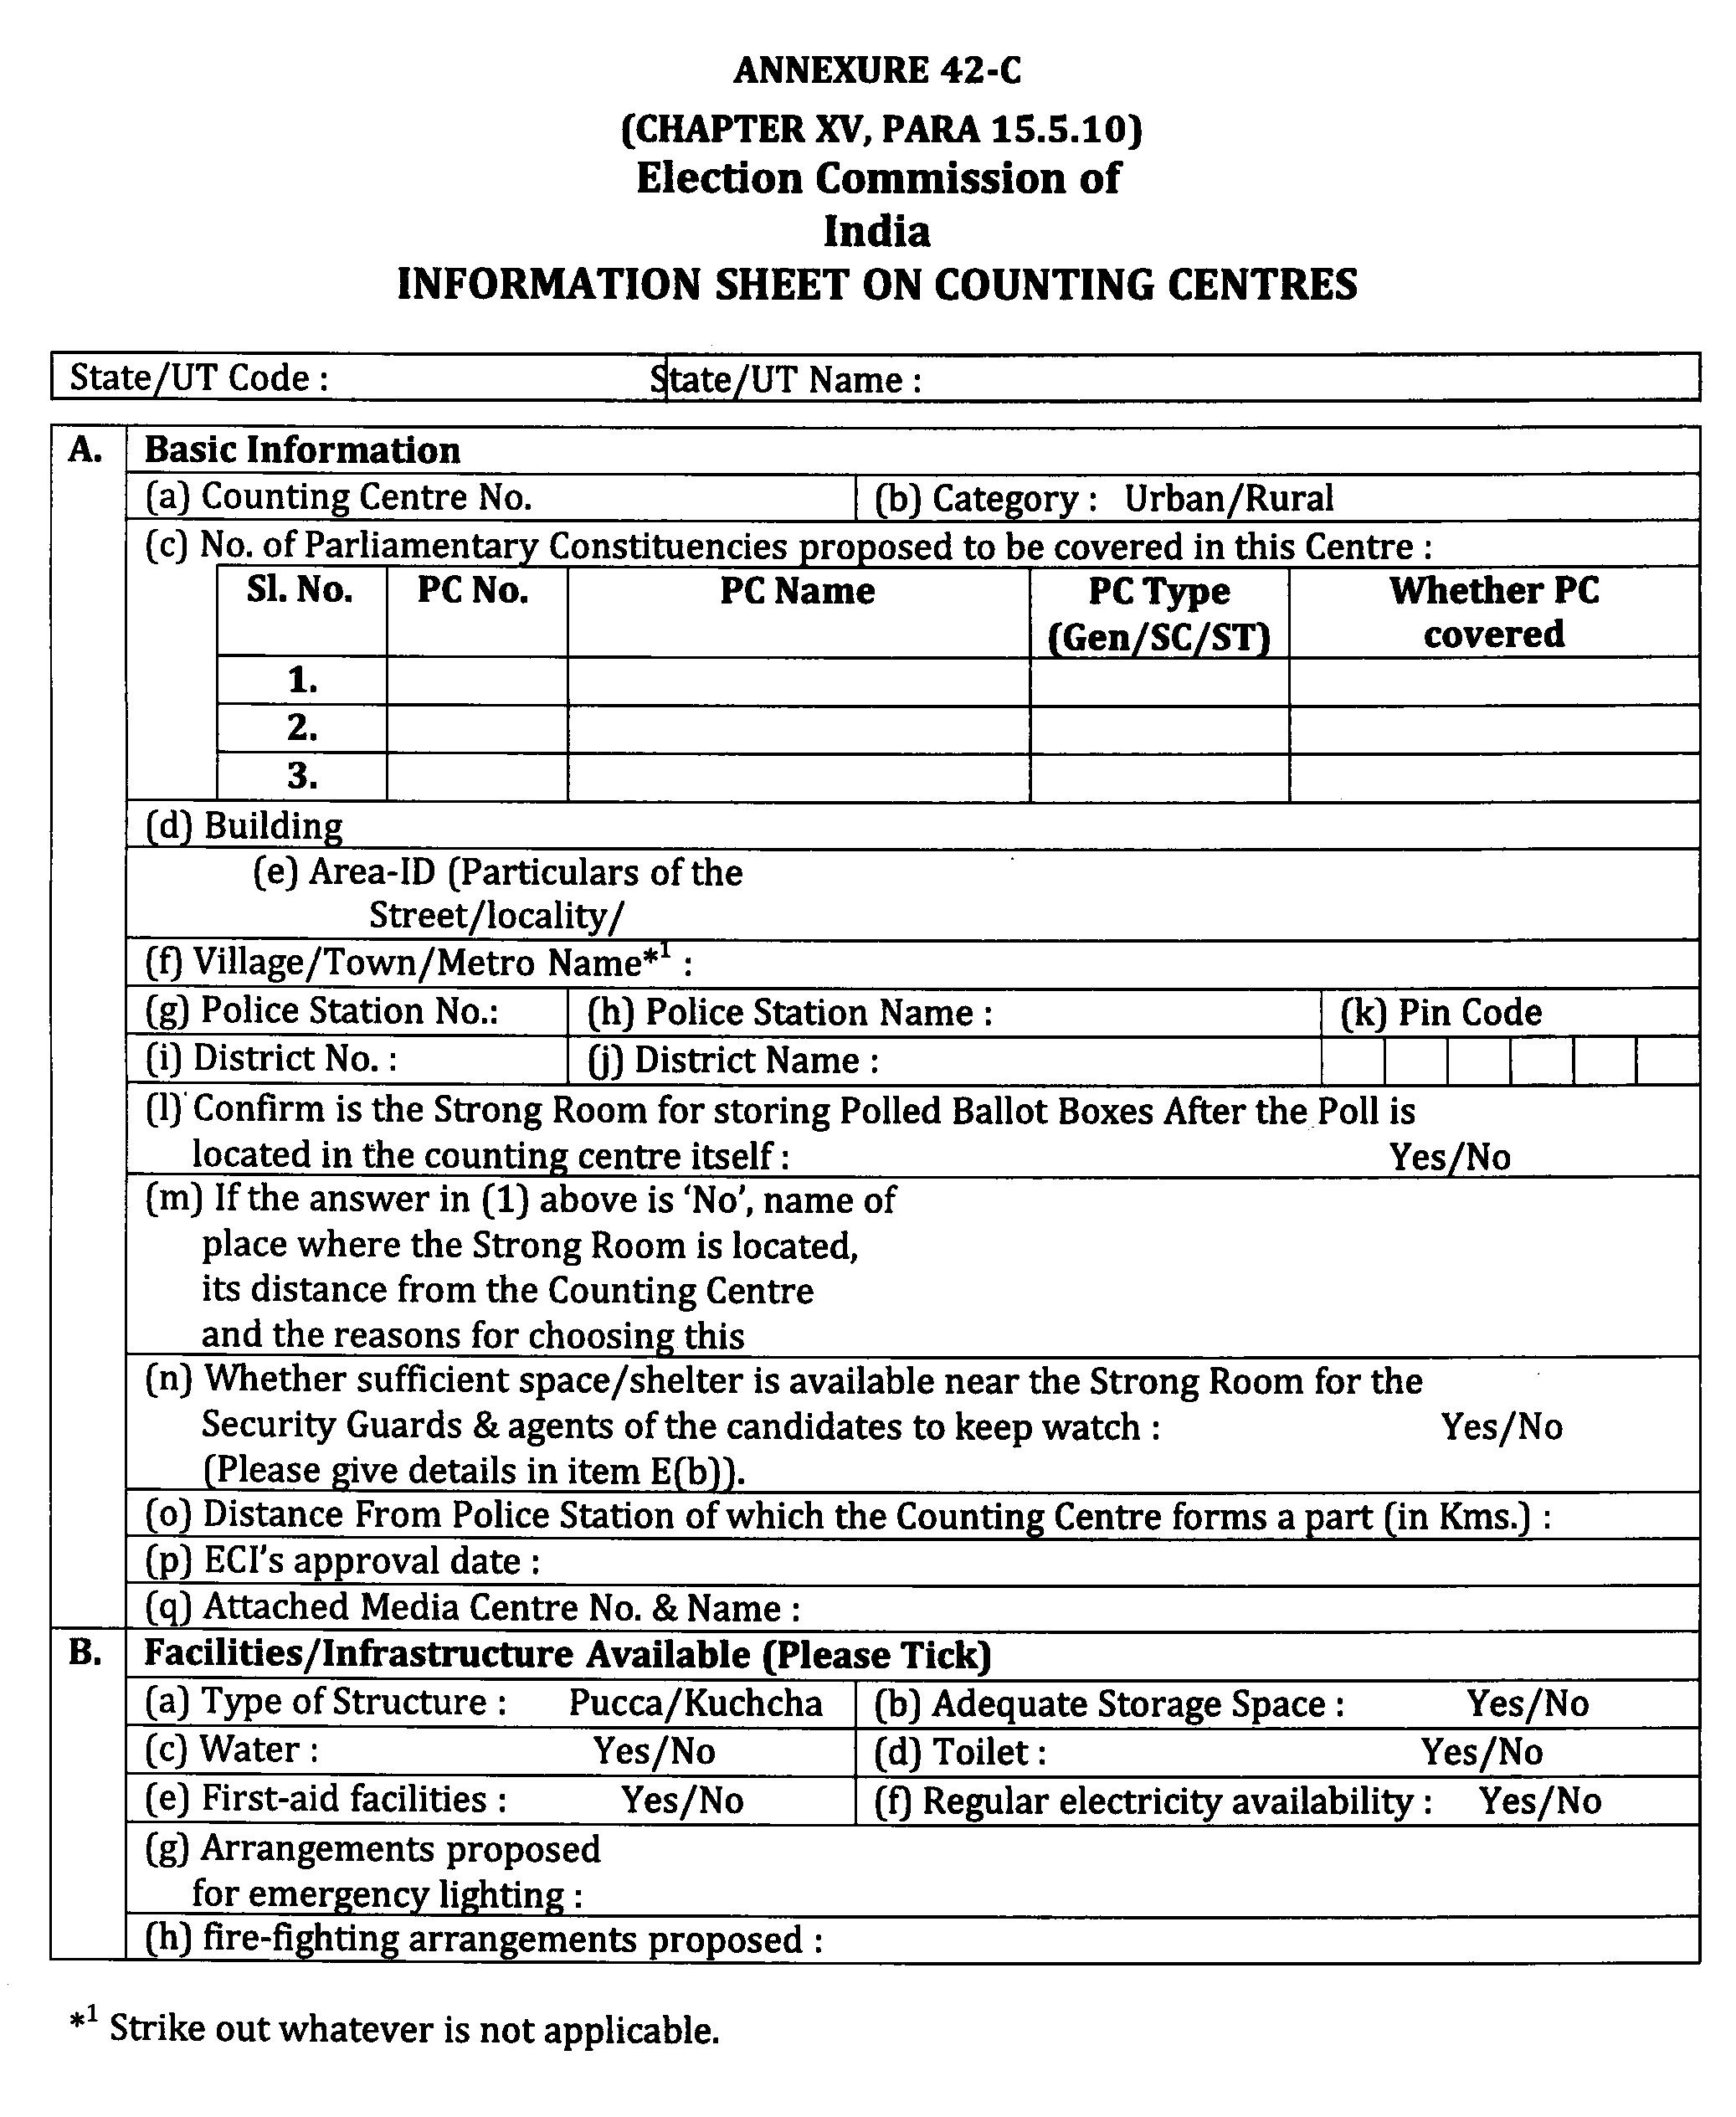

Slide 29
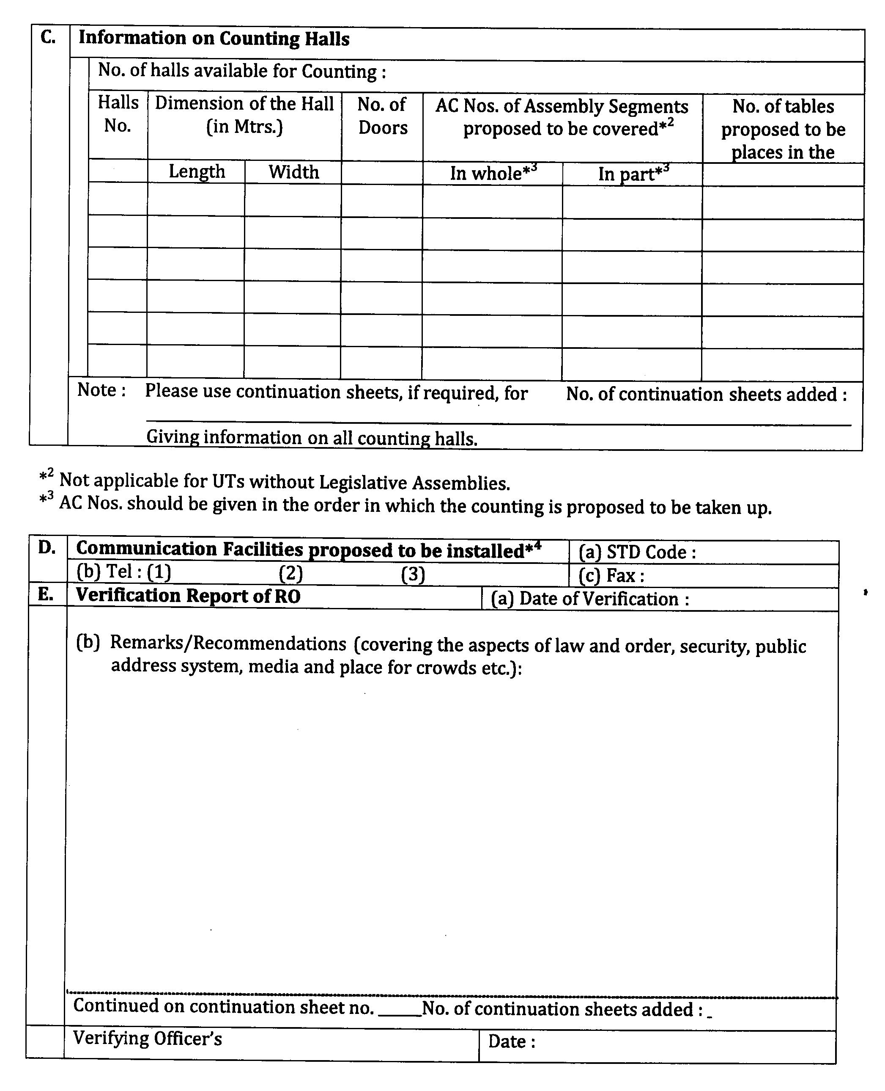
19

Slide 30
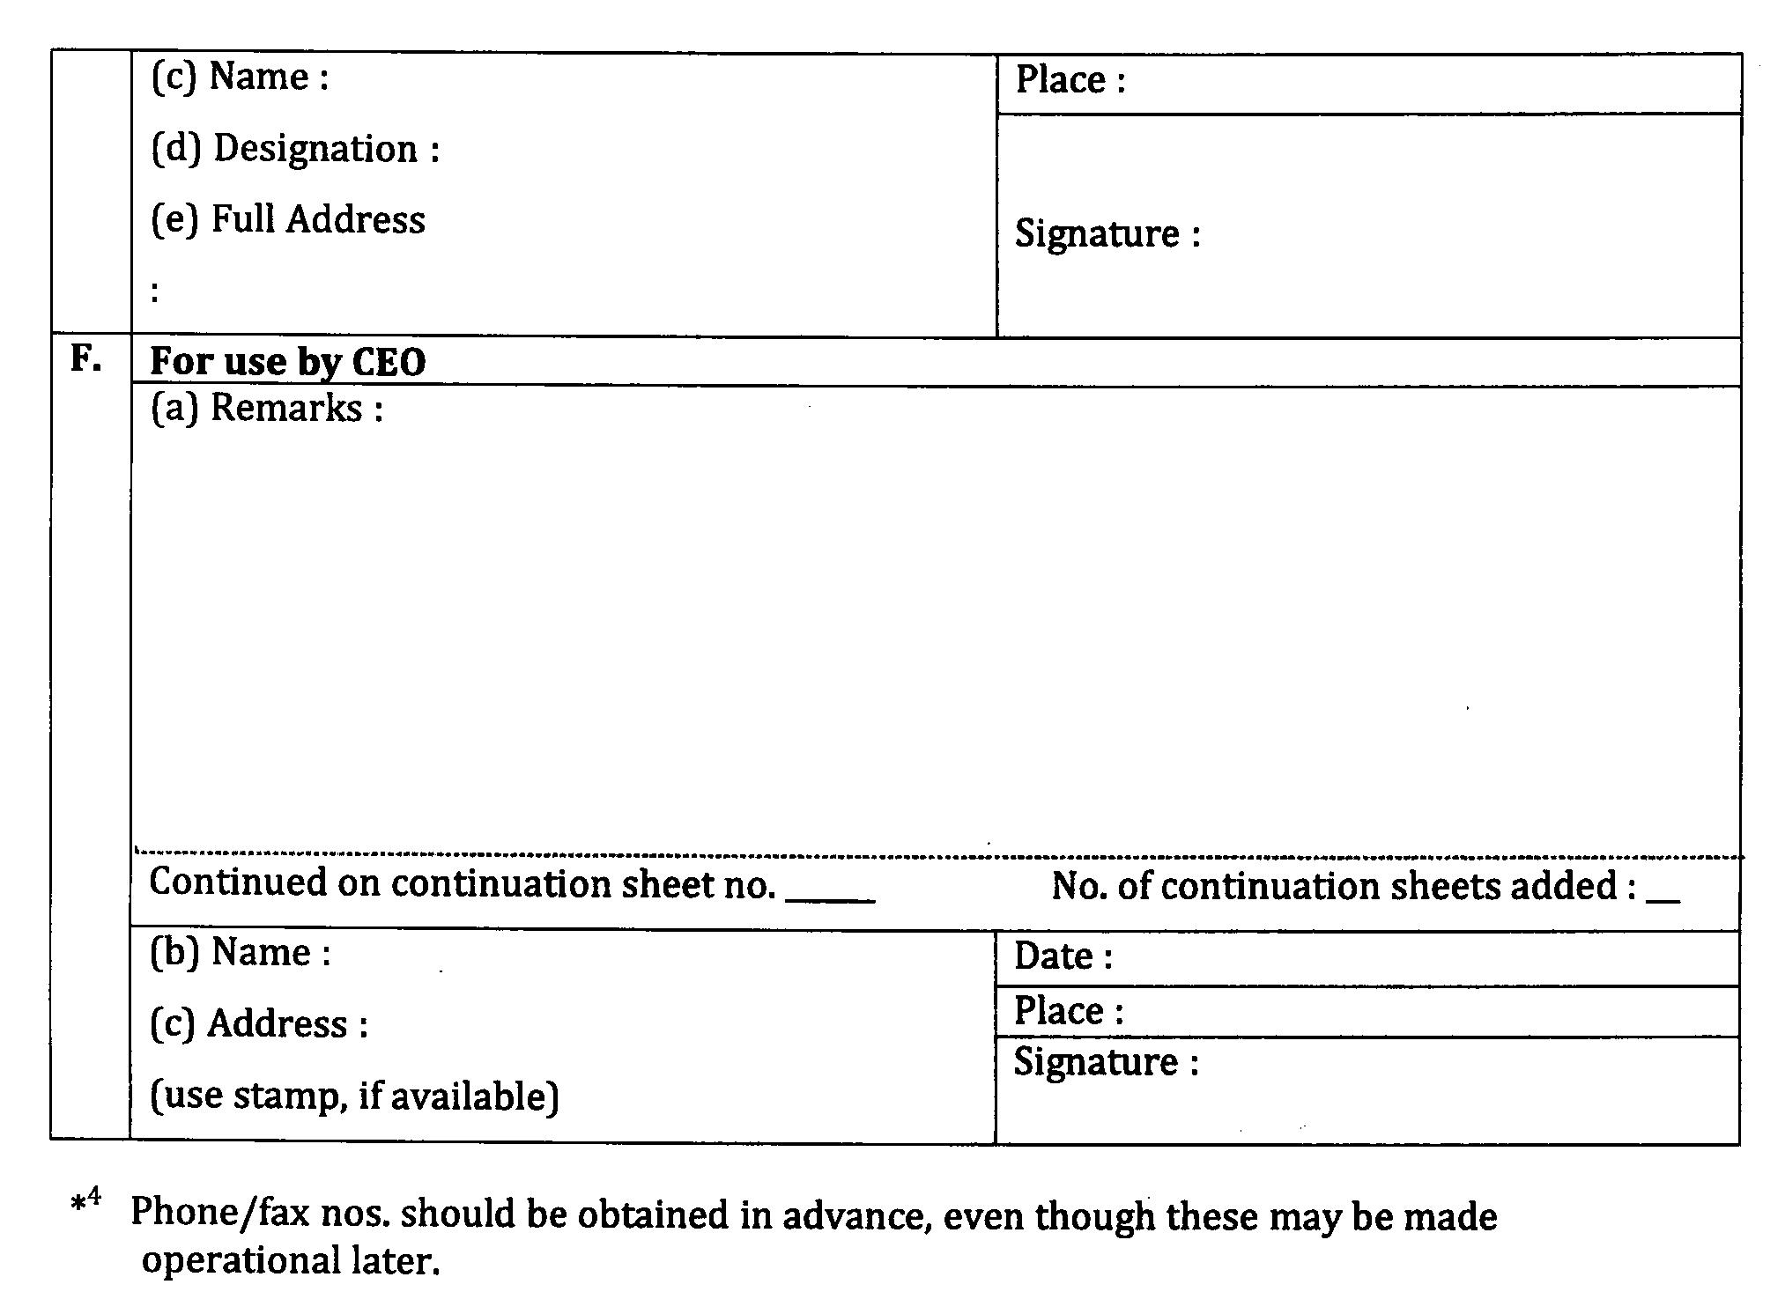
20

Slide 31
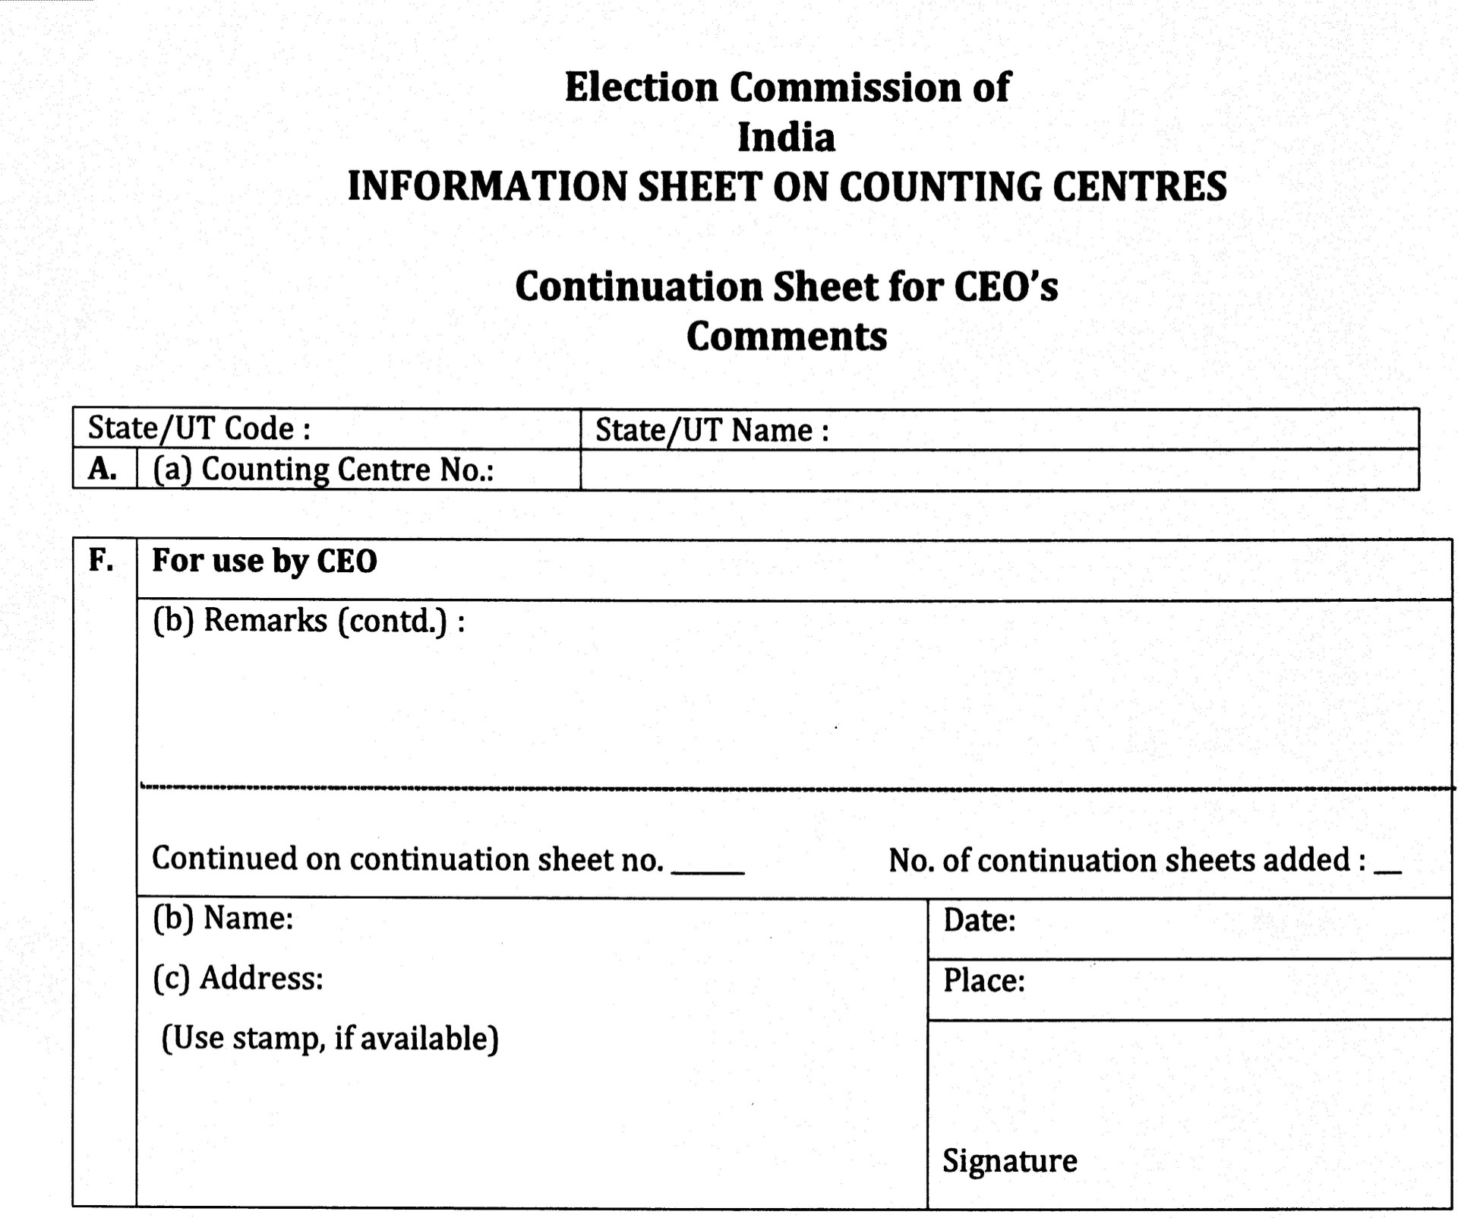

Slide 32
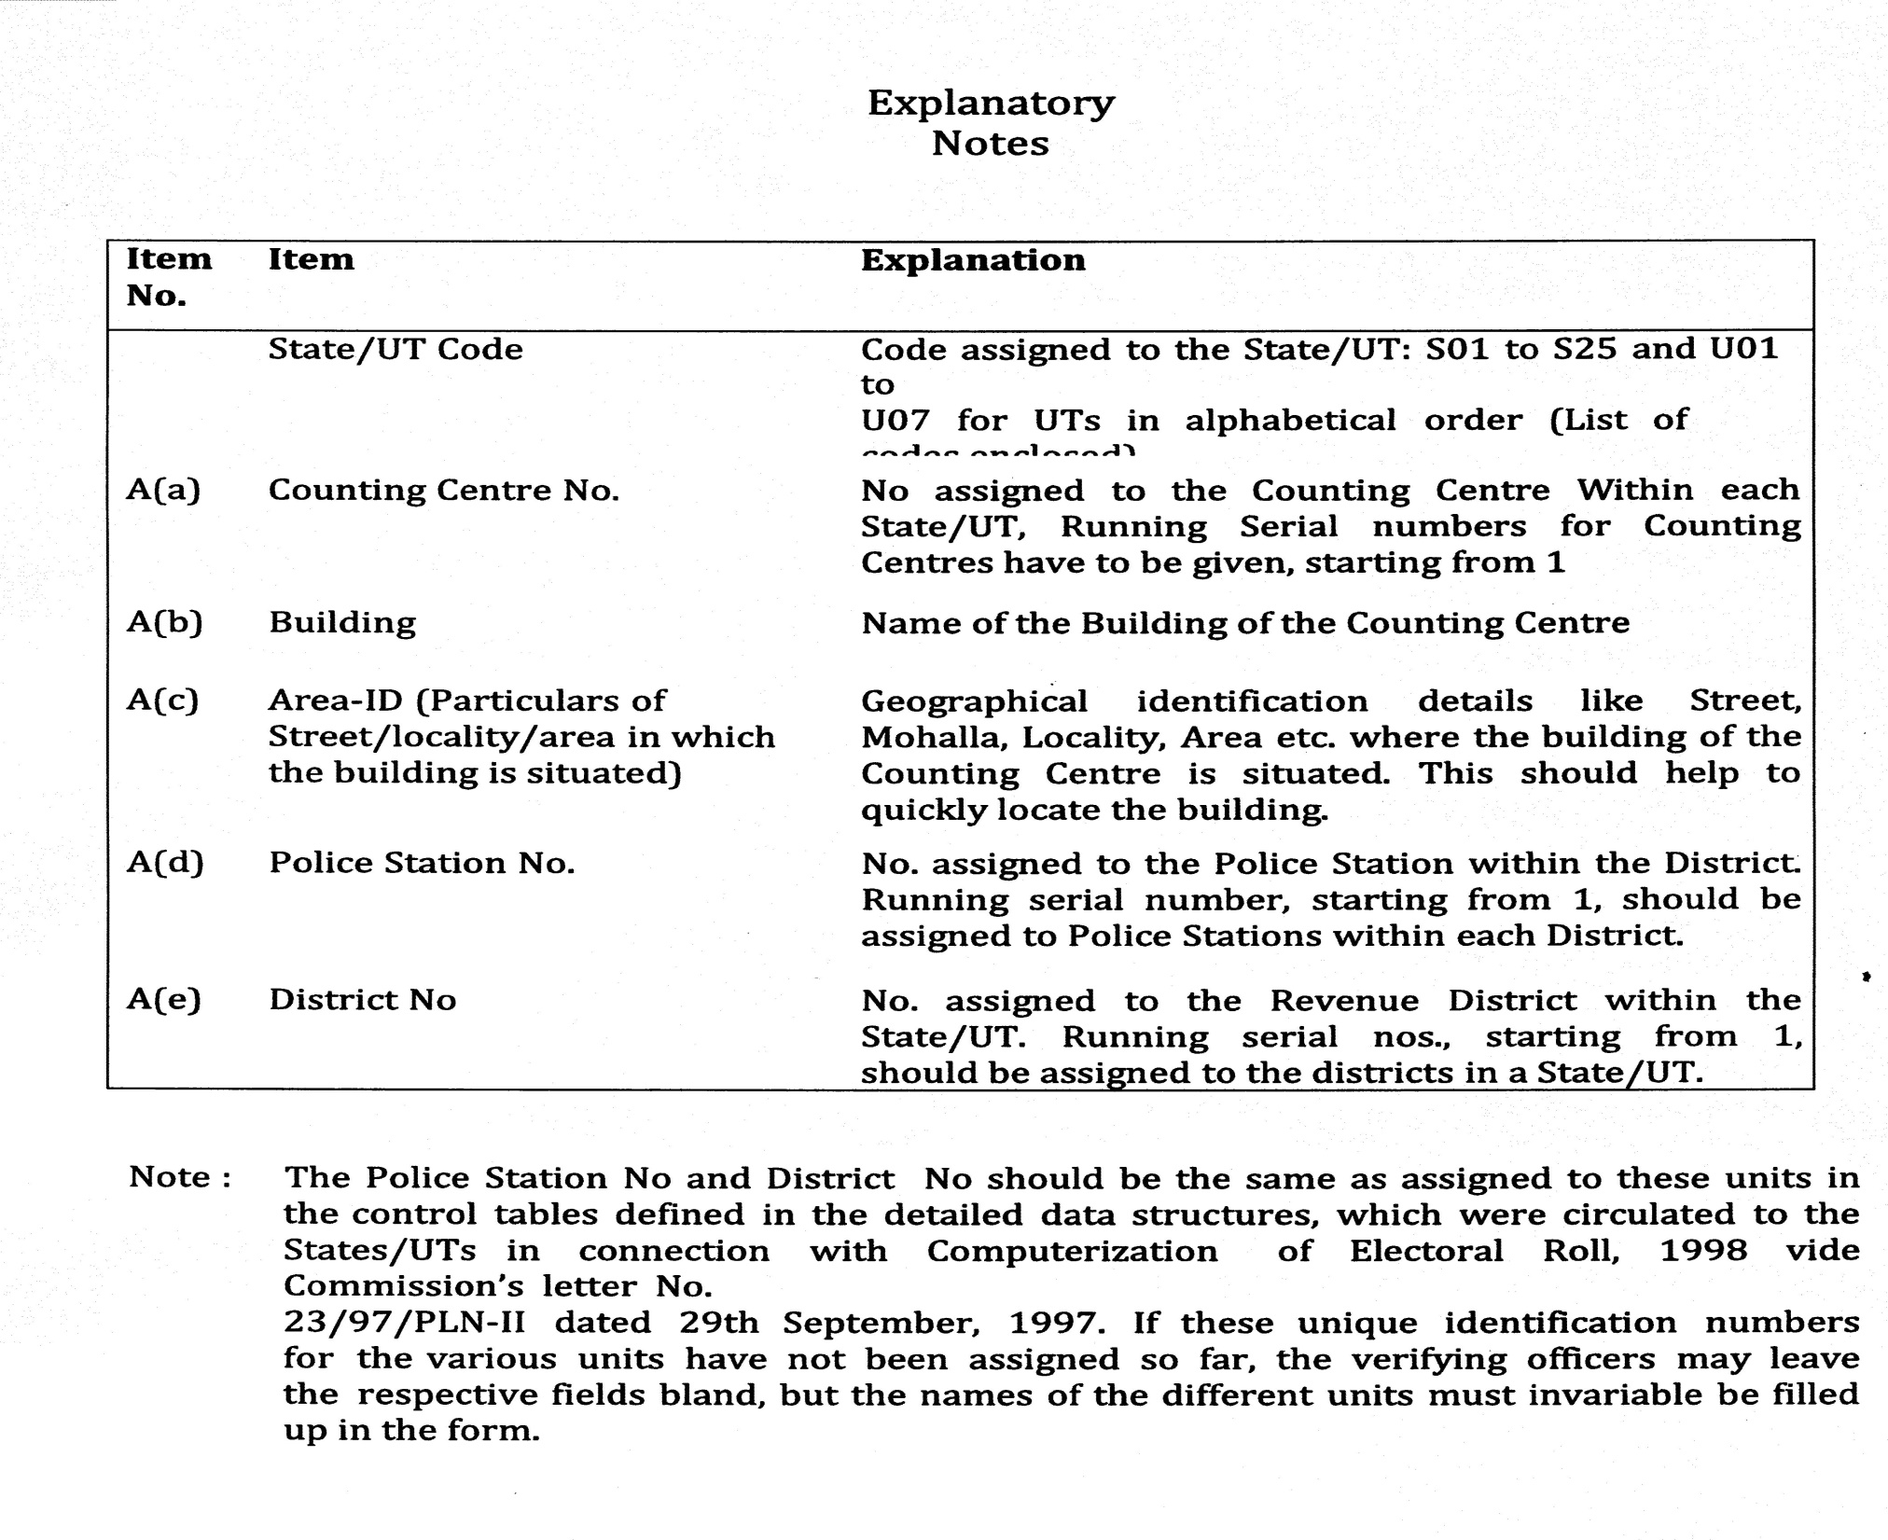

Slide 33


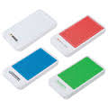
Counting Centre Arrangements (Rooms)
Communication: Table/chair, telephone, STD, fax, computer, printer, scanner and internet connection
Observer- Table/chair, TV, telephone, STD, fax, computer, printer, scanner and internet connection
Mobile Room- For storage/safe keeping of mobile by Candidate/ Agents etc.

Slide 34
Infrastructure arrangements at counting centres
Arrangements at counting centre for RO:
  A hotline with CEO
  One more STD telephone to keep in touch with CEO & ECI
  Fax and photocopy machine at counting centre
  Computer centre with power backup with facility for online transmission through GENESYS
  NOTE :only ECI observers is allowed to use mobile phone inside the counting hall.
  Public Communication Room-
  From here candidates and their agents can use their mobile. Suitable arrangements to keep mobile phones .

Slide 35
Management inside Counting Hall
Candidate and election agent can go to any table from outside the Chicken Mesh.
No person is allowed to enter or leave hall without RO’s permission.
No smoking
Videography (with date & time stamp)- Video in safe custody of DEO. RO to give CD of counting process to all candidate/ election agents free of cost.

Slide 36
Management inside Counting Hall
RO shall carry the mobile phone linked with ETPBS for receiving OTP to log into the system.
It will be switched off once the ETPBS system is logged in and kept with the Observer.
No one else other than the Observer can carry mobile phone.

Slide 37

Media Management
Media Pass to be issued in advance.
Media Centre- Separate room, adequate space, telephone, STD, fax, computer, printer, scanner and internet connection. Mobile allowed.
Media Centre to Counting Hall- Guided tour in small groups for small duration.
Inside Counting Hall- No mobile, No recording of actual vote recorded in EVM.
RO in advance should mark a line or fix one string to limit the access inside counting hall.

Slide 38
Infrastructure and security arrangements at counting centres
SECURITY ARRANGEMENTS
At Storage place of polled EVMs-
  TWO tier security arrangements round the clock at the strong rooms having polled EVMs.
  Innermost perimeter by CAPF and outer perimeter by State Armed Police(SAP).
  The candidates representatives to be allowed to stay outside the inner perimeter at a location which enables them to view entry points of the strong room. If no direct view, then CCTV arrangements to be made. So that they can see the gates of strong rooms. In CCTV case, they shall be taken periodically in batches to strong room to see and verify themselves strong room.
  Round the clock control room in an adjacent room with a Gazetted officer.
  A log book shall be maintained by the CAPF to record date, time, duration and names of any one, Including DEO/SP/RO/Observer/Candidates or their agents etc, crossing the 2nd ring.

Slide 39
Infrastructure and security arrangements at counting centres
SECURITY ARRANGEMENTS
(Continued from previous slide)
The CPF contingent shall be given a camera to record such visits. Last but not least, all entry points of strong room should be under constant videography using web cam and laptops. Person deputed to take back up from lap top should be issued a photo- I card and his names etc be intimated to CPF posted there.
DEO shall visit storage campus (up to inner perimeter only) everyday morning and evening, if storage campus is in district HQ. If outside then by the RO, but DEO to visit at least once in 3-4 days.
Round the clock uninterrupted power supply, adequate fire extinguishers etc. to be arranged for.
No vehicle, official or private shall be allowed inside the secured campus.

Slide 40
Infrastructure and security arrangements at counting centres
SECURITY ARRANGEMENTS
At Counting centres-
First of all, secure and smooth movement of EVMs from strong room to counting hall and vice versa , has to be ensured.
100 meter perimeter around a counting premise to be demarcated as ‘Pedestrian Zone ‘. Must be duly barricaded with an entry gate to enter into counting premise and no vehicle should be allowed to cross this.
Three tier cordoning system. The 1st and outer cordon to start from pedestrian zone. Must have adequate local police forces with a senior magistrate to check identity of the entrants. Persons with photo I cards issued by ECI or DEO only to be allowed to cross.
2nd cordon will be at the gate of counting premise/campus and will be manned by SAP. Checking of identity and frisking ( only by state police personnel) to be done.
3rd cordon at the door of counting hall where CAPF is to be present. Frisking to ensure that no one enters with mobile and other prohibited items.

Slide 41
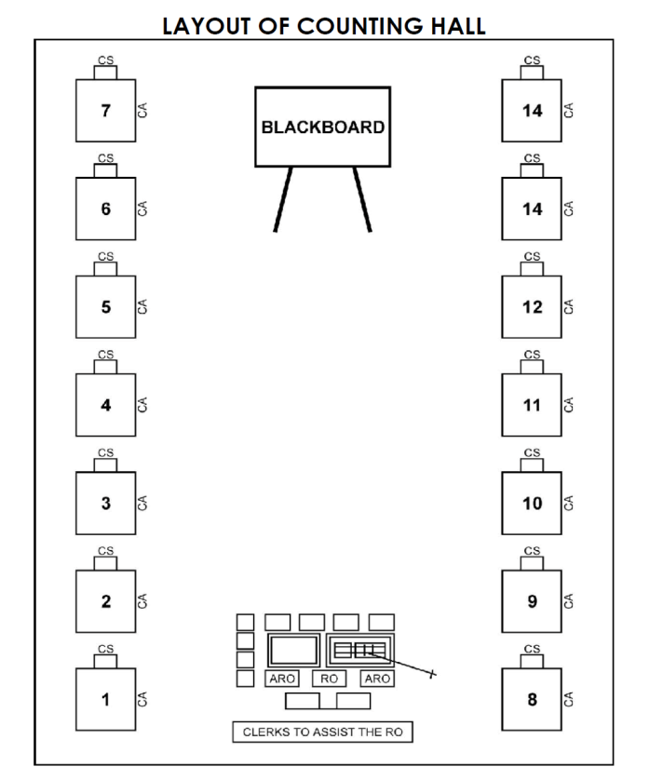

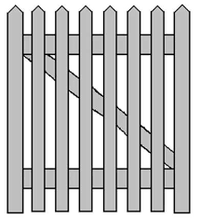


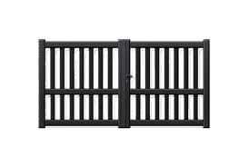
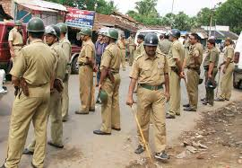
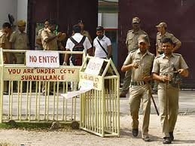
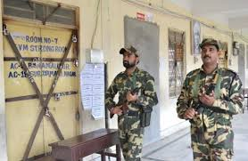
Pedestrian Zone
Counting Centre Security Management
2ND Tier
(2nd Cordon)
Counting Centre/Building
(1st Cordon)
(No Vehicle, Local Police, I-Card Checking, Magistrate)
Boundary Wall
Media Centre
Counting Hall 1
Metal Detector, Frisking,
Cordon II
Counting Hall 2
Local Police Force
Cordon I
State Armed Police
Building Gate
Cordon III
100 Meter
Mobile storage/safe keeping Room
Central Armed Police Force
Strong Room Force to be deployed

Slide 42
Infrastructure and security arrangements at counting centres
PERSONS ALLOWED INTO COUNTING HALL
Counting supervisors and assistants
Persons authorized by ECI
Public servants on duty in connection with election
Candidates, their election agents and counting agents
Every body inside the counting hall shall have to display his I-card on his/her person.
24

Slide 43
PERSONS NOT ALLOWED INTO COUNTING HALL
Police personnel, whether in uniform or plain clothed, NOT allowed. Must remain outside and can enter only when called by RO to come to control
Ministers, State Ministers, Dy. Ministers of Union & state unless they are candidates
The above cannot be appointed as election or counting or polling agent of candidate as they require security
Counting agents cannot enter unless/he has submitted 2nd copy of appointment letter after completing and signing declaration

Slide 44
Presence of SPG Protection with SPG Protectee in Counting Hall
ECI NO. 470/INST/2014-EPS Dated: 13th May, 2014
Contesting candidates who are SPG protected to be accompanied inside the counting hall with one SPG personnel in plain clothes with "one concealed arms.”

Slide 45
Infrastructure and security arrangements at counting centers
PRIORITY IN SEATING IN COUNTING HALL
(subject to seating capacity)
1. Agents of candidates of recognized national parties
2. Agents of candidates of recognized state parties
3. Agents of candidates of recognized state parties of other states permitted to use reserve symbol
4. Agents of candidates of registered unrecognized parties
5. Agents of Independents Candidates

Slide 46
DISCIPLINE & DECORUM IN COUNTING HALL
Agents to keep seated at allotted table.
Agents shouldn’t be allowed to move around the hall. However, Candidates/ Election Agents can move around hall.
Only one person – either candidate or agent to be present at a table on behalf of contesting candidate.
If RO doubts any person he can have him/her searched, even if they possess valid authorization letter.
CAPF officials posted at doors of counting hall.
No one can enter or leave hall without RO’s permission.
RO can send anyone out of hall if they disobey RO’s orders.

Slide 47
1.3
Appointment of Counting Staffs and Counting Agents

Slide 48
Counting staff & counting agents
Counting staff is appointed by the RO concerned.
Format of Appointment letter prescribed in Annexure-44 of HB of RO.
Requirement to be assessed on basis of no. of counting halls and no. of counting tables plus reserve. For each table:
  One Counting Supervisor (preferably a Gazetted officer of Central/ State govt. or officer of equivalent status of PSUs.
  One Counting Assistant
  One micro observer (a Central Govt. official)
  One Group D employee
  Small team for VVPAT ballot slip Counting
  Also --
  Reserve staff
  Additional Counting Assistant for Observer to do parallel counting

Slide 49
Annexure 44

Slide 50
Counting Personnel / Counting Agent ( Per table)
Personnel | EVM Counting | ETPBS/Postal Ballot Counting
Counting Supervisor | 1 | 1
Counting Assistant | 1 | 1
Micro Observer | 1 | 1
Counting Agent | 1 | 1
Staff for Counting Observer:
Addl. Counting Staff | Random checking of two EVMs per round
Addl. Counting Staff | VVPAT Counting Booth (VCB)
1st Micro Observer | Keep watch over the data entry in computer
2nd Micro Observer | Re-check on the printout

Slide 51
Randomization of Counting Personnel
Sl No | Randomization | Responsibility | Process | Time frame | Objective | Appointment letter to be issued by
1 | First | DEO | Using computer | One week prior to counting | To segregate 120% counting officials | DEO
2 | Second | DEO + Observer | Using computer | 24 hrs prior to counting | AC wise segregation | RO
3 | Third | DEO + Observer | Computer/ Manual | At 5 am on date of counting (must be completed by 6 am) | Counting Table allocation | RO
Videography
Observers to appoint Micro Observers

Slide 52
Counting Agents
Each Candidate- To appoint counting Agents- all EVM counting tables + RO’s Table + PB/ETPBS Tables + Compilation table.
To be Appointed in Form- 18 (in duplicate).
Declaration to be signed in RO’s presence.
List of Counting Agents in Form 18, with their photos for all contesting candidates by 1700 hrs on 3 days prior to the date of counting.
Counting Photo I-Card to be issued- agents to affix their signature.

Slide 53
Counting Agents
The law does not prescribed any specific qualifications for persons to be appointed as counting agents.
Candidates are advised to appoint mature persons who are above 18 years as their counting agents.
Any sitting minister either of Union Government/ State Government, sitting MP/MLA/ MLC, Mayor or Chairperson of Municipality/Zila Parishad/Panchayat Samity or any other person with security cover will not be allowed to act as a counting agent.

Slide 54
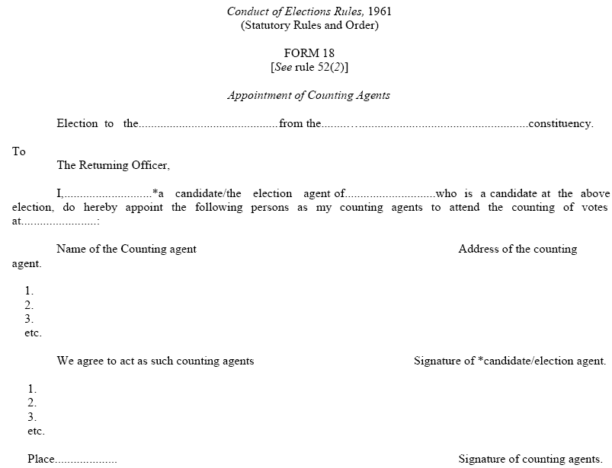
Form 18: Appointment of Counting Agents

Slide 55
Counting staff & counting agents
RO to inform each contesting candidate that he is entitled to as many counting agents as there are counting tables plus one for RO table and one for tabulation table.
Any application on plain paper to be rejected. Form 18 to be submitted in duplicate. The RO will keep one copy and return the 2nd copy. On counting day, the agents will sign the declaration part of the Form 18 and give it to the RO.
Issue photo identity cards to such counting agents under your seal and sign- No entry into counting hall without I-card

Slide 56
Counting staff & counting agents
Appointment of counting agents in Form 18. Revocation in Form 19.
Finalize list of counting agents appointed through Form 18 by 1700 hours 3 days prior to date of counting
Counting agent should sign on badge immediately.

Slide 57
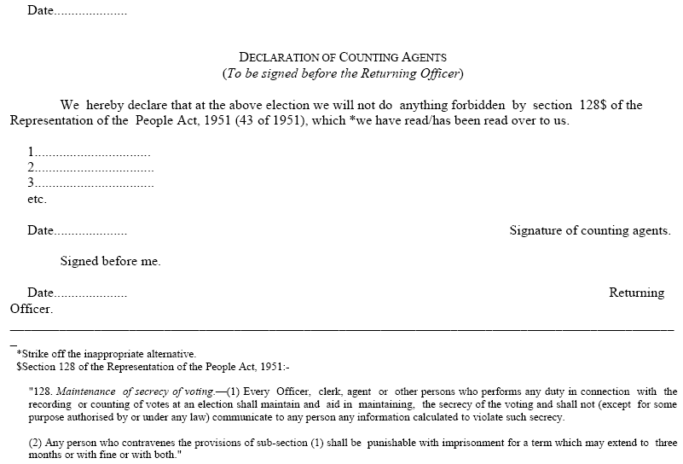
Form 18: Appointment of Counting Agents
32

Slide 58
Thanks

